Slide 1
NativeScript
Open-source framework for building truly native mobile apps with Angular, TypeScript or JavaScript.
Notes:
Thanks everyone for coming out today to hear about NativeScript, my name is TJ VanToll. I’m on the NativeScript team... (switch)

Slide 2
TJ VanToll 🚀
@tjvantoll
Notes:
and I want to start by asking how many people here are from the greater Atlanta area?
Well for those of you that are, I feel like there’s something I absolutely have to confess here before getting started, something that will probably cause you to lose any respect you have for me.
You see Atlanta...

Slide 3
Notes:
I’m a massive Tom Brady fan.
You see just for a little bit of context here, I’ve lived in Michigan my entire life. I’ve been a sports fan all my life also, but I was an absolute fanatic when I was in high school.
And around that time Tom Brady was the QB for the Michigan Wolverines.

Slide 4
Notes:
This picture here is Brady leading a comeback win in the 2000 Orange Bowl against Alabama.
And at that moment, Tom Brady, to me, became a God that could do no wrong.
So I was quite happy with the Patriots Super Bowl win, but if makes you feel better, if you’re a sports fan you might know that my own Detroit Lions...

Slide 5
Notes:
are a dumpster fire, and have been for 50 years.
But I’m not here to talk to you about horrible professional sports franchises, I’m here to talk to you about NativeScript.

Slide 6
NativeScript is the best tool for cross-platform native app development 🎉
Notes:
And today I hope to prove to you that NativeScript the best tool for cross-platform native app development.
By cross-platform I specifically mean iOS and Android development. NativeScript is a framework for building iOS and Android apps, and we believe it’s a good idea.
2 caveats:
I’m a member of the {N} team, so I definitely have some bias here.
This doesn’t mean the {N} is the best fit for every mobile app

Slide 7
Agenda
Slides!
~20 minutes
Coding!
~30 minutes
Questions!
Whatever time we have left

Slide 8
Notes:
I was hired in at Telerik to talk about a brand new product that we were super proud of called Telerik AppBuilder.

Slide 9
Notes:
Introduce basics Apache Cordova / PhoneGap / Ionic

Slide 10
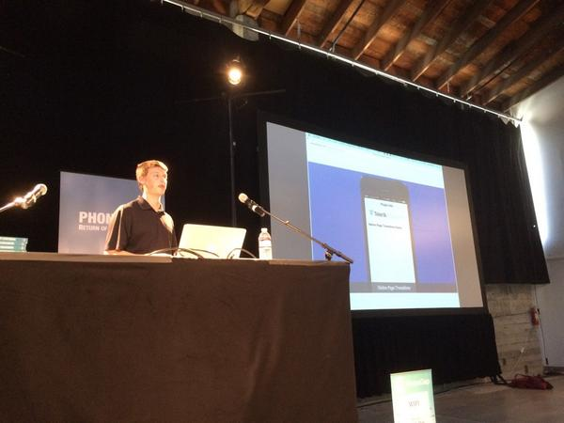
Me at PhoneGap Day 2014

Slide 11
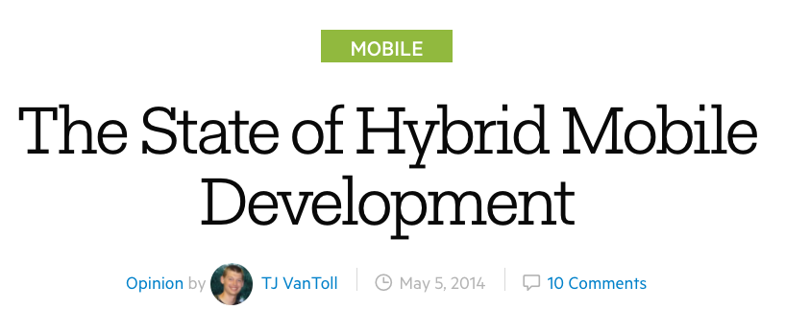
http://developer.telerik.com/featured/the-state-of-hybrid-mobile-development/

Slide 12
“We are facing a slow touch reaction while scrolling”
“I've noticed very slow/jaggy/flickering scrolling on Android. The framerate is low, and the scroll effect is far from smooth.”
“if there is solution to get native speed then i will be using app builder again otherwise will move to native”
“appbuilder only produces a bastard child of an app. slow, and tacky . Its just not a good idea at all. Having said that it is actually what i am using for my next app. This is because every other alternative is just as bad.”

Slide 13
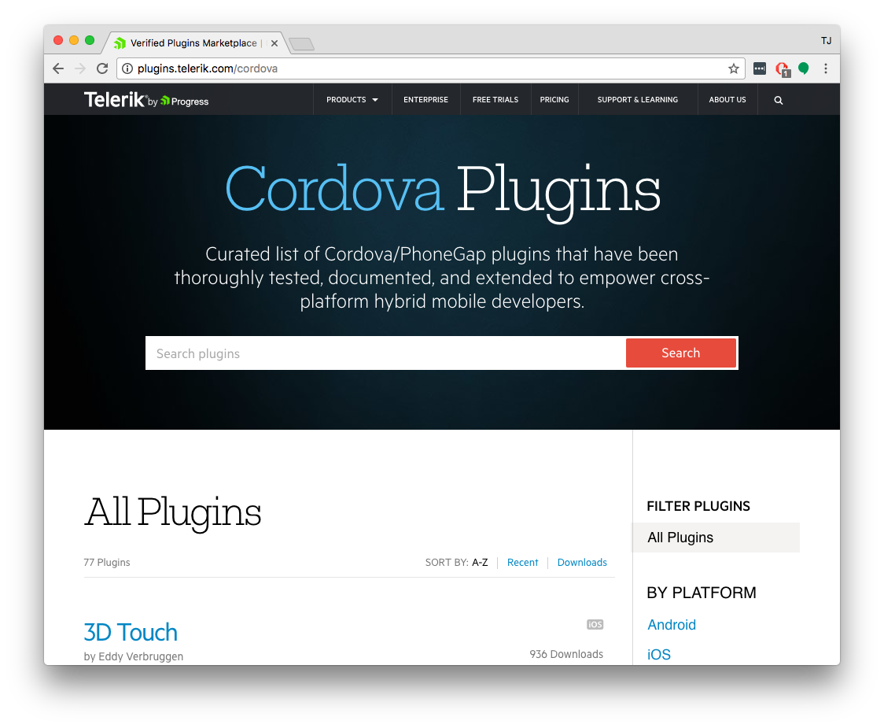
Notes:
I mention this because, in today’s world, where 10 JavaScript frameworks have been created since I started this presentation, that it’s important to pick an innovative and stable options

Slide 14
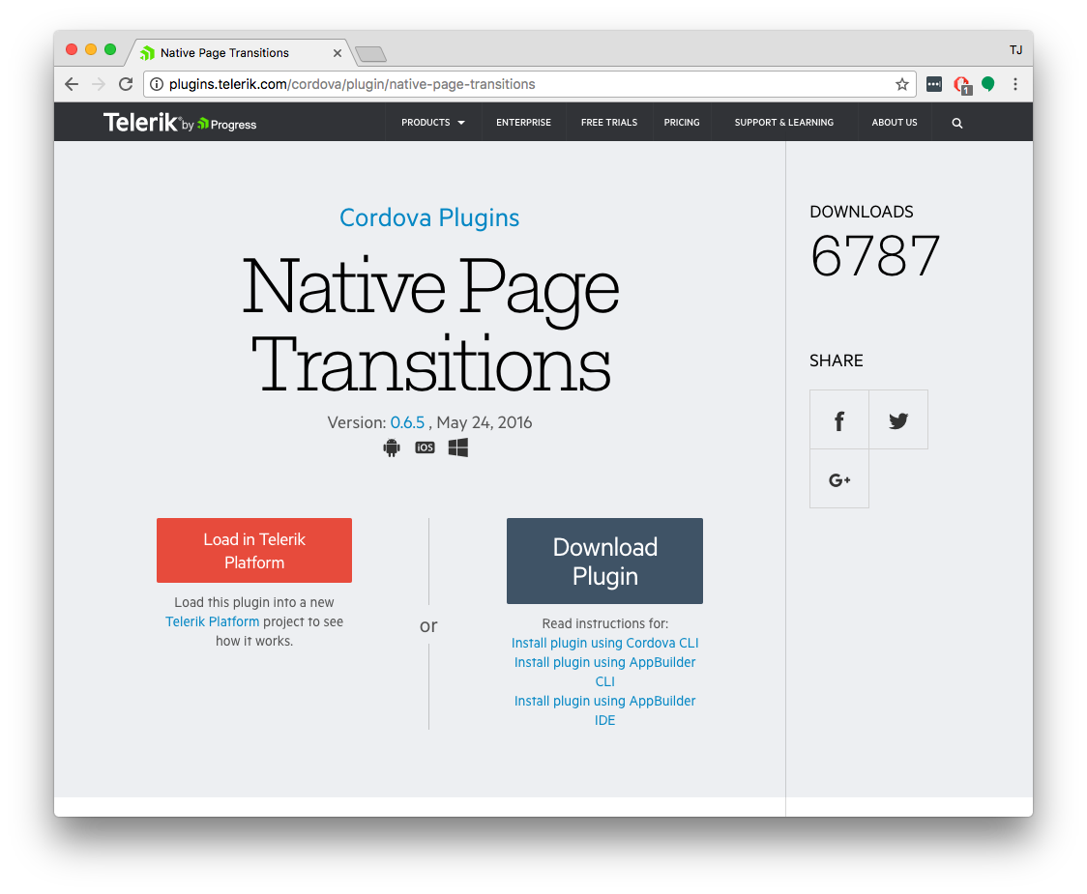

Slide 15
Early prototypes
“Core” engineering
Public launch
Adoption ramp-up
Mass adoption
2013
2014
2015
2016
2017
Project Timeline

Slide 16
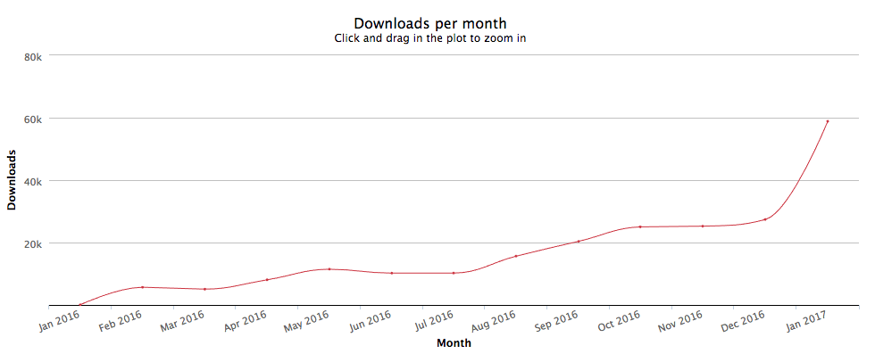
https://npm-stat.com/charts.html?package=nativescript&from=2016-01-31&to=2017-01-31

Slide 17
NativeScript is…
A free and open source framework for building truly native mobile apps with JavaScript. Use web skills, like TypeScript, Angular and CSS, and get native UI and performance on iOS and Android.

Slide 18
NativeScript is the best tool for cross-platform native app development 🎉
Notes:
By cross-platform I specifically mean iOS and Android development. NativeScript is a framework for building iOS and Android apps, and we believe it’s a good idea.
2 caveats:
I’m a member of the {N} team, so I definitely have some bias here.
This doesn’t mean the {N} is the best fit for every mobile app

Slide 19
5 reasons

Slide 20
1
Rich, animated, “no compromise” native UI 🐎
(with shared UI code)
Search for
“Examples NativeScript”
in the iOS App Store or Google Play to try this out for yourself.
Notes:
And then later, when you’re back at home or in the office, you can check out nativescript.org/showcases...

Slide 21
2
Maximum code and skill reusability 🌮
Notes:
Npm, CocoaPods, Android Arsenal

Slide 22
Architecture Choices 🔧
or
or

Slide 23
3
Ease of doing native-y things 📷

Slide 24
NativeScript modules
Notes:
To start NativeScript provides dozens of built-in modules that abstract complex native functionality behind simple-to-use JavaScript and TypeScript APIs. For example, to allocate a file in a NativeScript app you import a File constructor and invoke it, as opposed to writing the native code you see on the bottom of the screens.

Slide 25
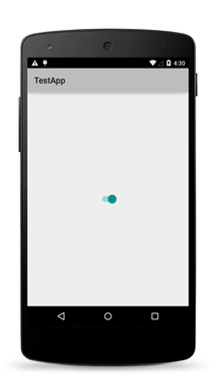
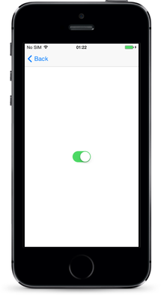
NativeScript modules for UIs
Notes:
There are a number of NativeScript modules that help you build your user interfaces in markup rather than complex native code. The slide shows the switch component, and you can find the full list at docs.nativescript.org/ui/components.

Slide 26
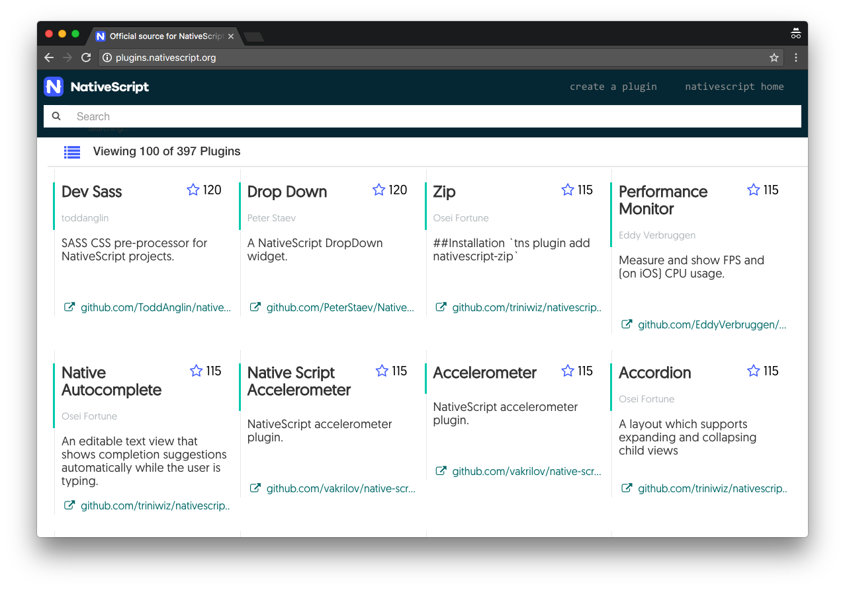
NativeScript Plugins Hub (plugins.nativescript.org)
Notes:
To build upon the built-in modules, the NativeScript community builds and maintains a robust set of NativeScript plugins—adding to the things you functionality you can quickly and easily add to your NativeScript apps.

Slide 27
Reuse existing native Android and iOS libraries

Slide 28
4
Vibrant and growing community 💖

Slide 29
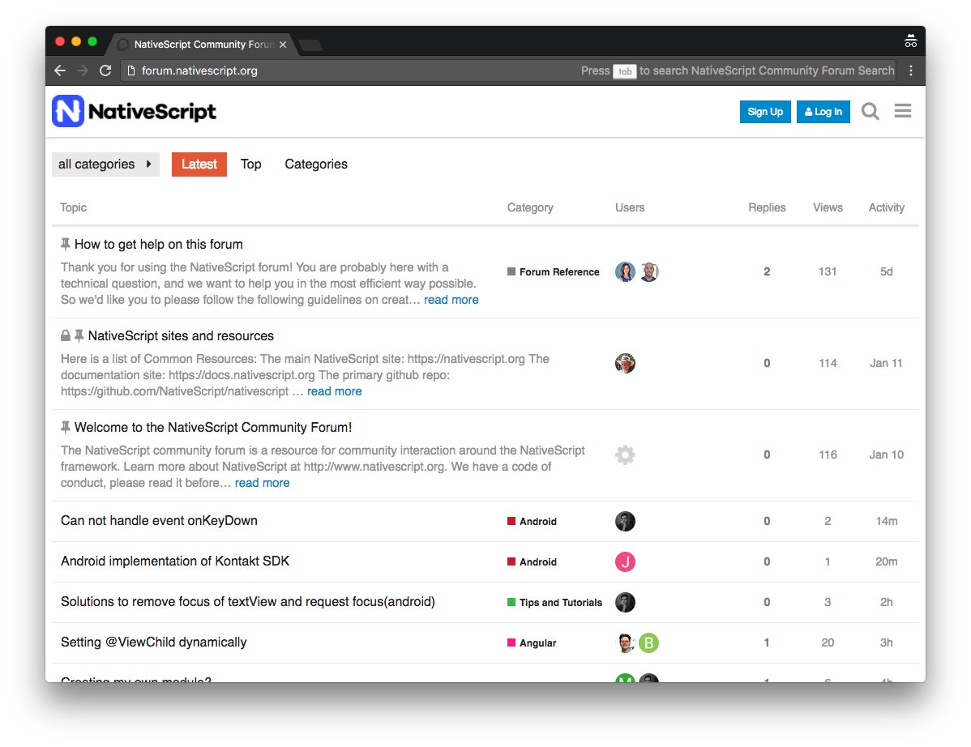
NativeScript community forum (forum.nativescript.org)
Notes:
The NativeScript community forum at forum.nativescript.org is a great place to ask questions and get help from the greater NativeScript community.

Slide 30
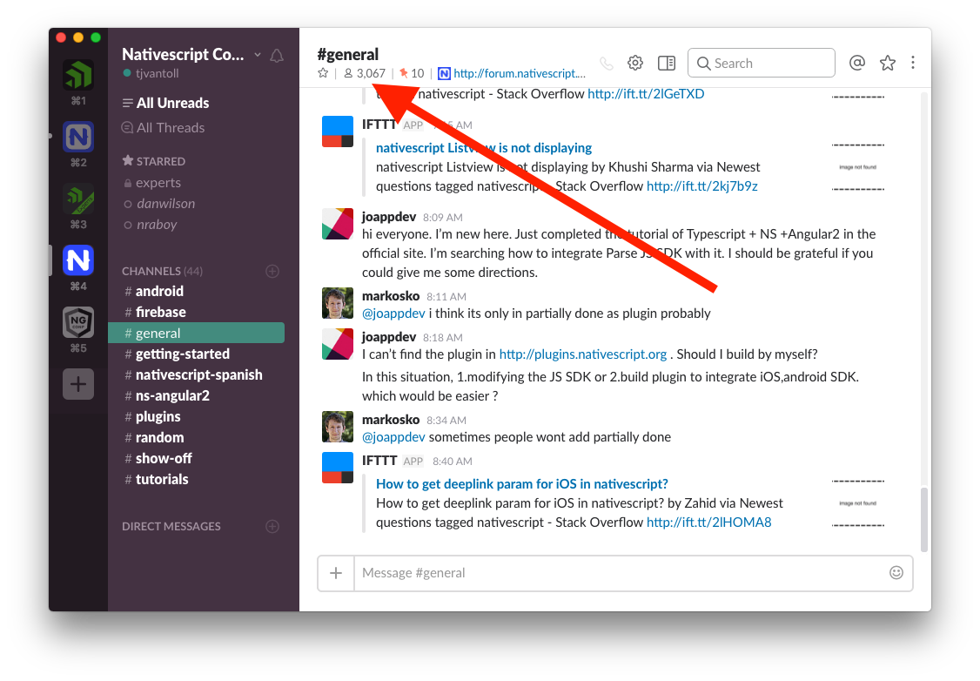
NativeScript community Slack channel
Notes:
The NativeScript community Slack channel is a great place to chat with others in the NativeScript community—over 3000 members!

Slide 31
5
Supported by a major software company vested in your success 👨‍💼👩‍💼

Slide 32
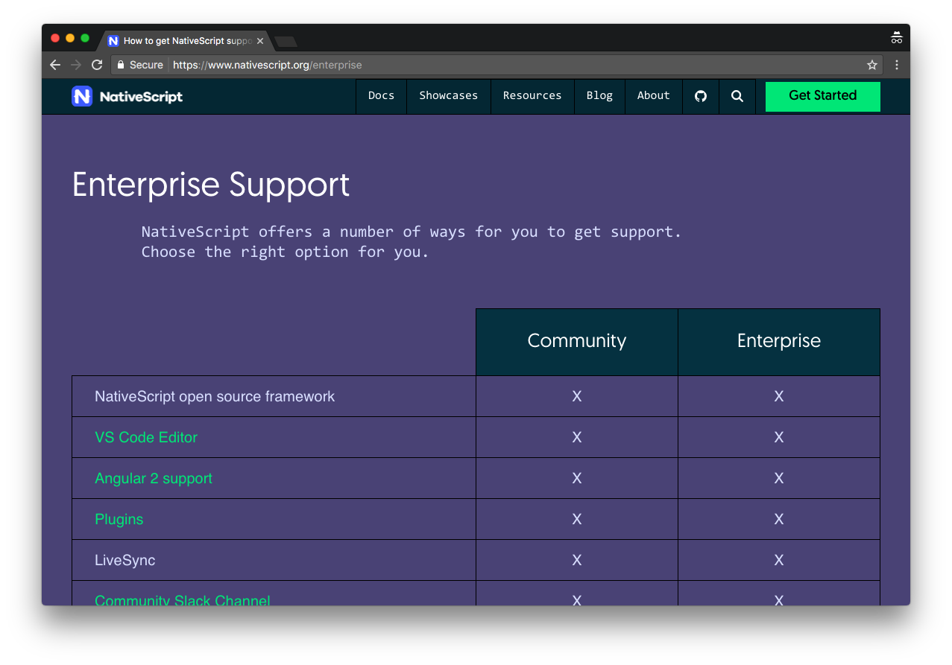
NativeScript offers enterprise support
Notes:
The first is enterprise support. If you work for a large company considering building NativeScript-based apps, the NativeScript team provides a variety of support options that can help make your app a success.

Slide 33
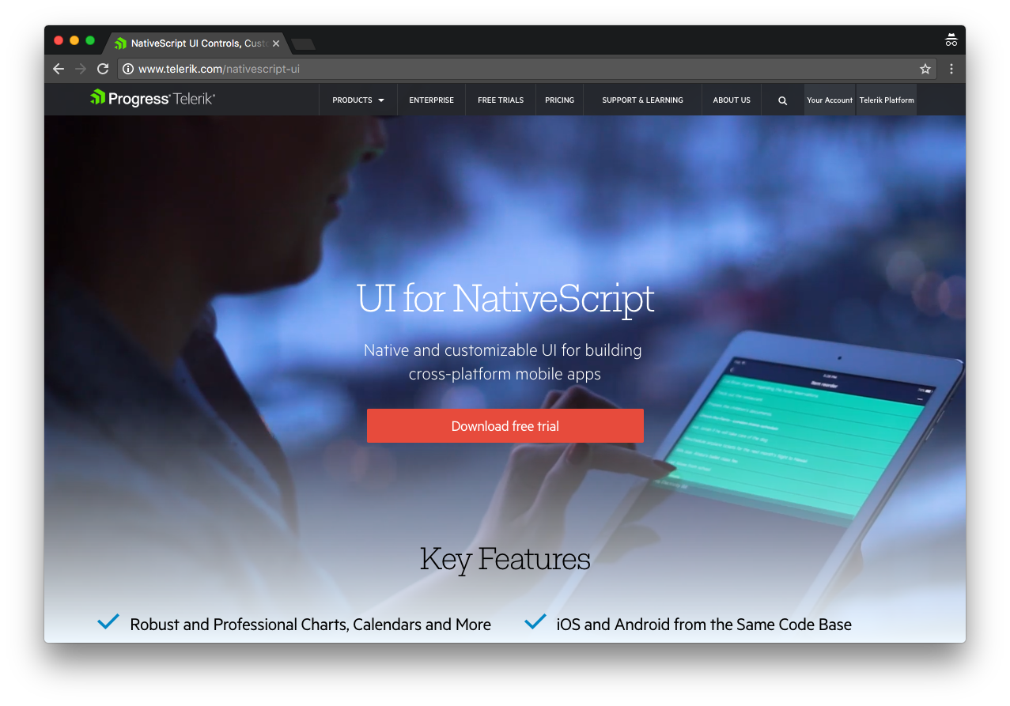
UI for NativeScript—premium UI components
Notes:
The second is premium UI components through a product named UI for NativeScript. UI for NativeScript contains a series of paid UI component, such as calendars, charts, and graphs.

Slide 34
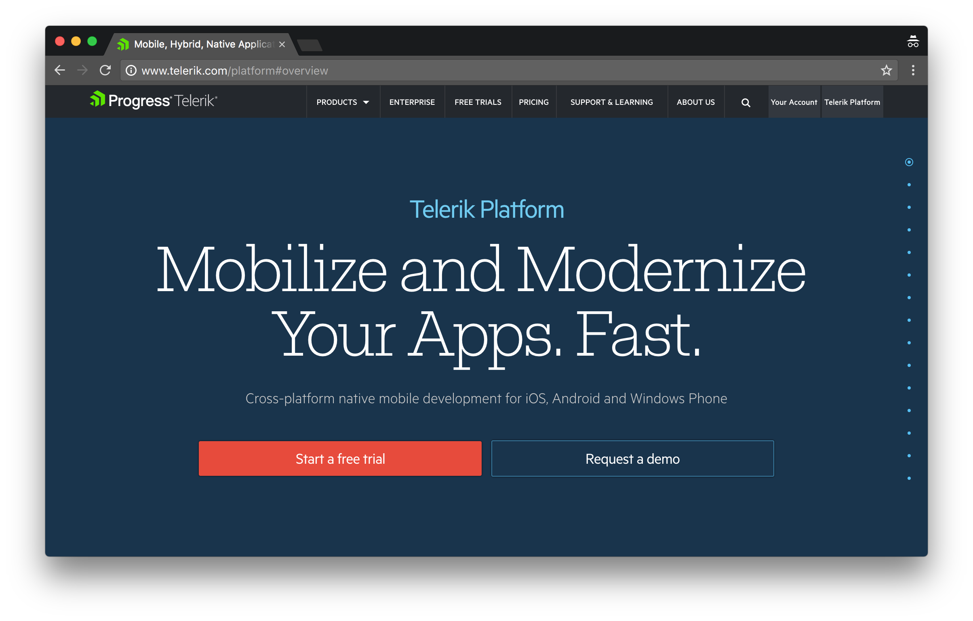
Telerik Platform
Notes:
The second is premium UI components through a product named UI for NativeScript. UI for NativeScript contains a series of paid UI component, such as calendars, charts, and graphs.

Slide 35
5 Reasons to use NativeScript
1) Rich, animated native UI
2) Maximum code and skill reusability
3) Ease of doing native-y things
4) Vibrant and growing community
5) Supported by a major software company

Slide 36
NativeScript is the best tool for cross-platform native app development 🎉

Slide 37
Demo! 🔥
Notes:
First though I have to reveal one more potentially personal fact about myself… and that’s that I’m a 31-year-old adult that’s an enormous Pokémon fan.

Slide 39
Notes:
I’m a level 34 Pokemon GO player, which, for those of you that don’t play Pokémon GO, it basically means that I make very questionable use of my free time.

Slide 40
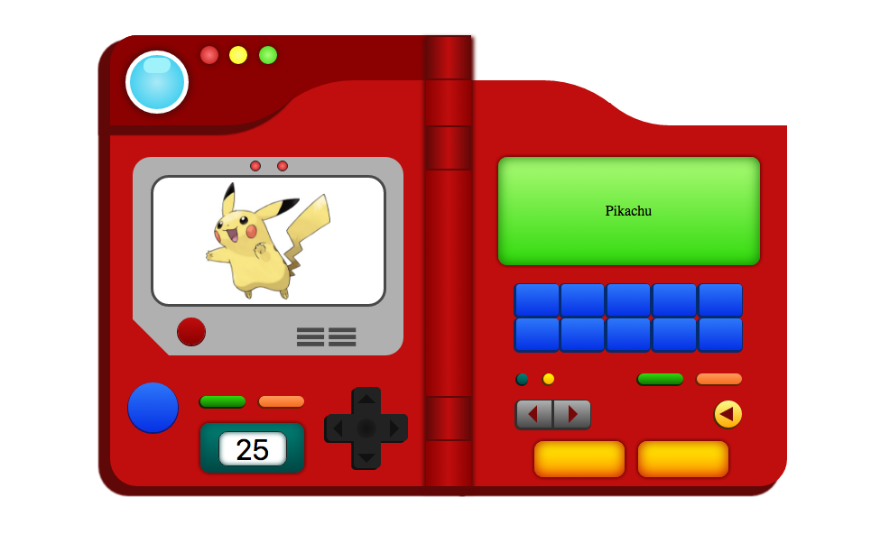
Notes:
But, Pokémon

Slide 41
How many Pokémon are there?
801

Slide 42
Follow NativeScript!
nativescript.org/nativescript-newsletter
twitter.com/nativescript
Notes:
Want to keep up on the latest and greatest in the NativeScript world? Sign up for the NativeScript newsletter, and follow the @NativeScript handle on Twitter.

Slide 43
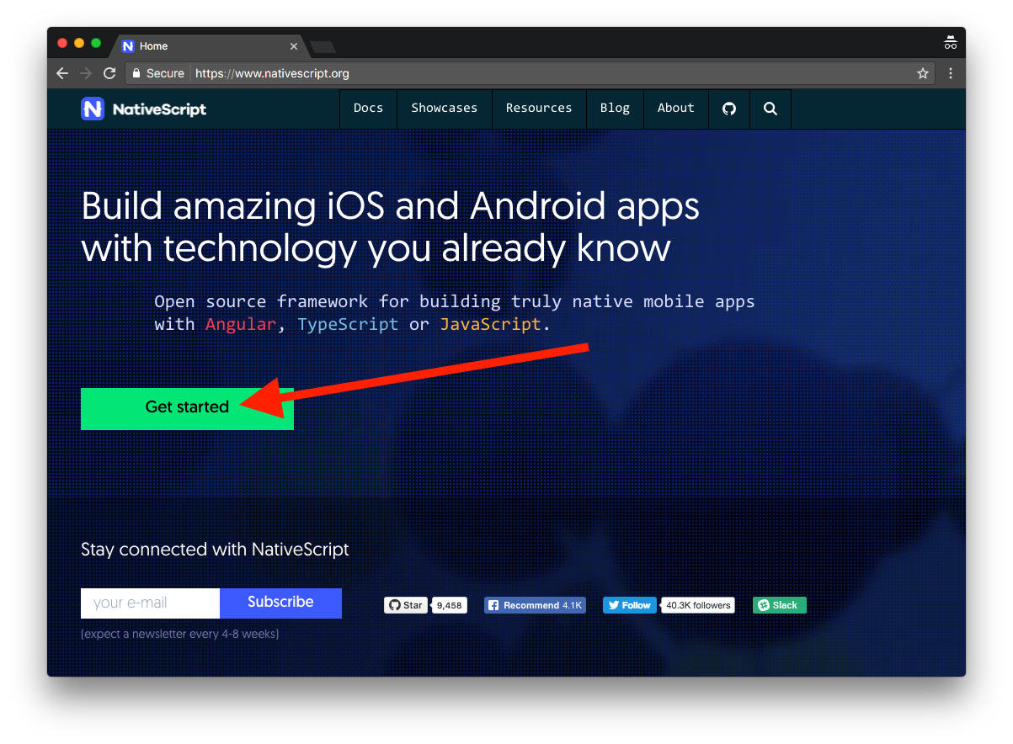
Get Started
Notes:
If you’re interested in what you’ve heard today and want to try NativeScript out, head to nativescript.org and hit the big Get started button. From there go through one of the two tutorials, NativeScript with JavaScript, or NativeScript with TypeScript and Angular.

Slide 44
Thanks! 😊
@tjvantoll
Notes:
We have a booth (Progress)

